Slide 1


BLOG WEBSITE

Slide 2
Team Members
PIYUSH RAJPUT (2100290140101)
VIKAS PARMAR (2100290140146)
SHIVAM KUMAR (2100290140128)
Project Supervisor
Mr. Praveen Kumar Gupta(Assistant Professor)

Slide 3
Introduction to Blogging
A blog is an informational website published on the World Wide Web consisting of discrete, often informal diary-style text entries (posts). Posts are typically displayed in reverse chronological order so that the most recent post appears first, at the top of the web page.
Many blogs focus on a particular topic, such as web design, home staging, sports, or mobile technology on social media, especially when the content is long-form and one creates and shares content on regular basis. So, one could be maintaining a blog on Facebook or blogging on Instagram.

Slide 4
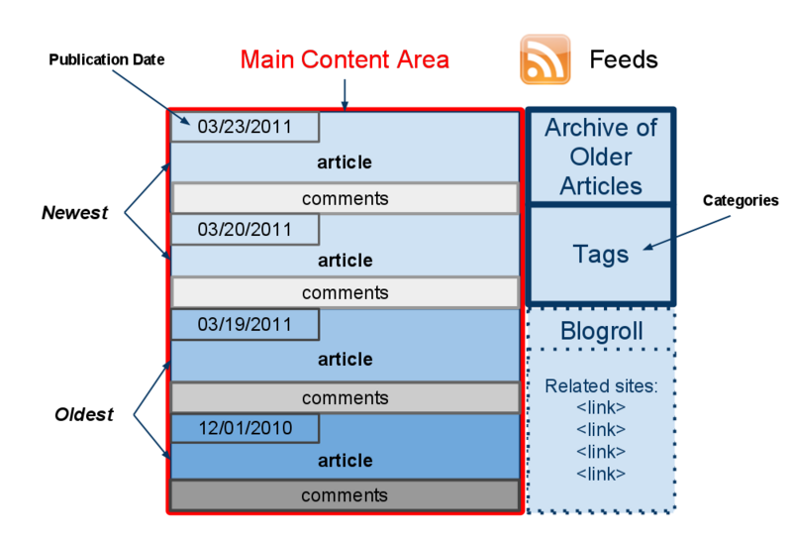
Main content area with articles listed chronologically:-
The articles are organized into categories:-
A way for people to leave comments about the articles.
A list of links to other related sites , sometimes called a “blogroll”-l is a list of links to blogs that the blogger likes
One or more "feeds" like RSS(Really Simple Syndication or Rich Site Summary) is a type of web feed that allows users and applications to receive regular updates from a website or blog of their choice.

Slide 5
Functionalities provided by Online Blogging System are as follows:
Provides the searching facilities based on various factors. Such as Blogs, New Category Blog, Content Management, Upload or embed pictures and multimedia.
It tracks Manage & all the information of Comment New Blog etc.
Editing, adding and updating of Records is improved which results in proper resource management of Blogs data.
Shows the information and description of the Blogs, New Category.

Slide 6
Technologies:
Software Requirements:
CSS
ReactJs
NodeJs
ExpressJs
MongoDB
Visual Studio Code
Web Browser

Slide 7
Hardware Requirement
Processor: Core i5
System Type 64-bit operating system
Hard Disk Space: 256 GB
Ram Memory: 8GB recommended
Operating System: Windows 10 or later
Internet : Required

Slide 8
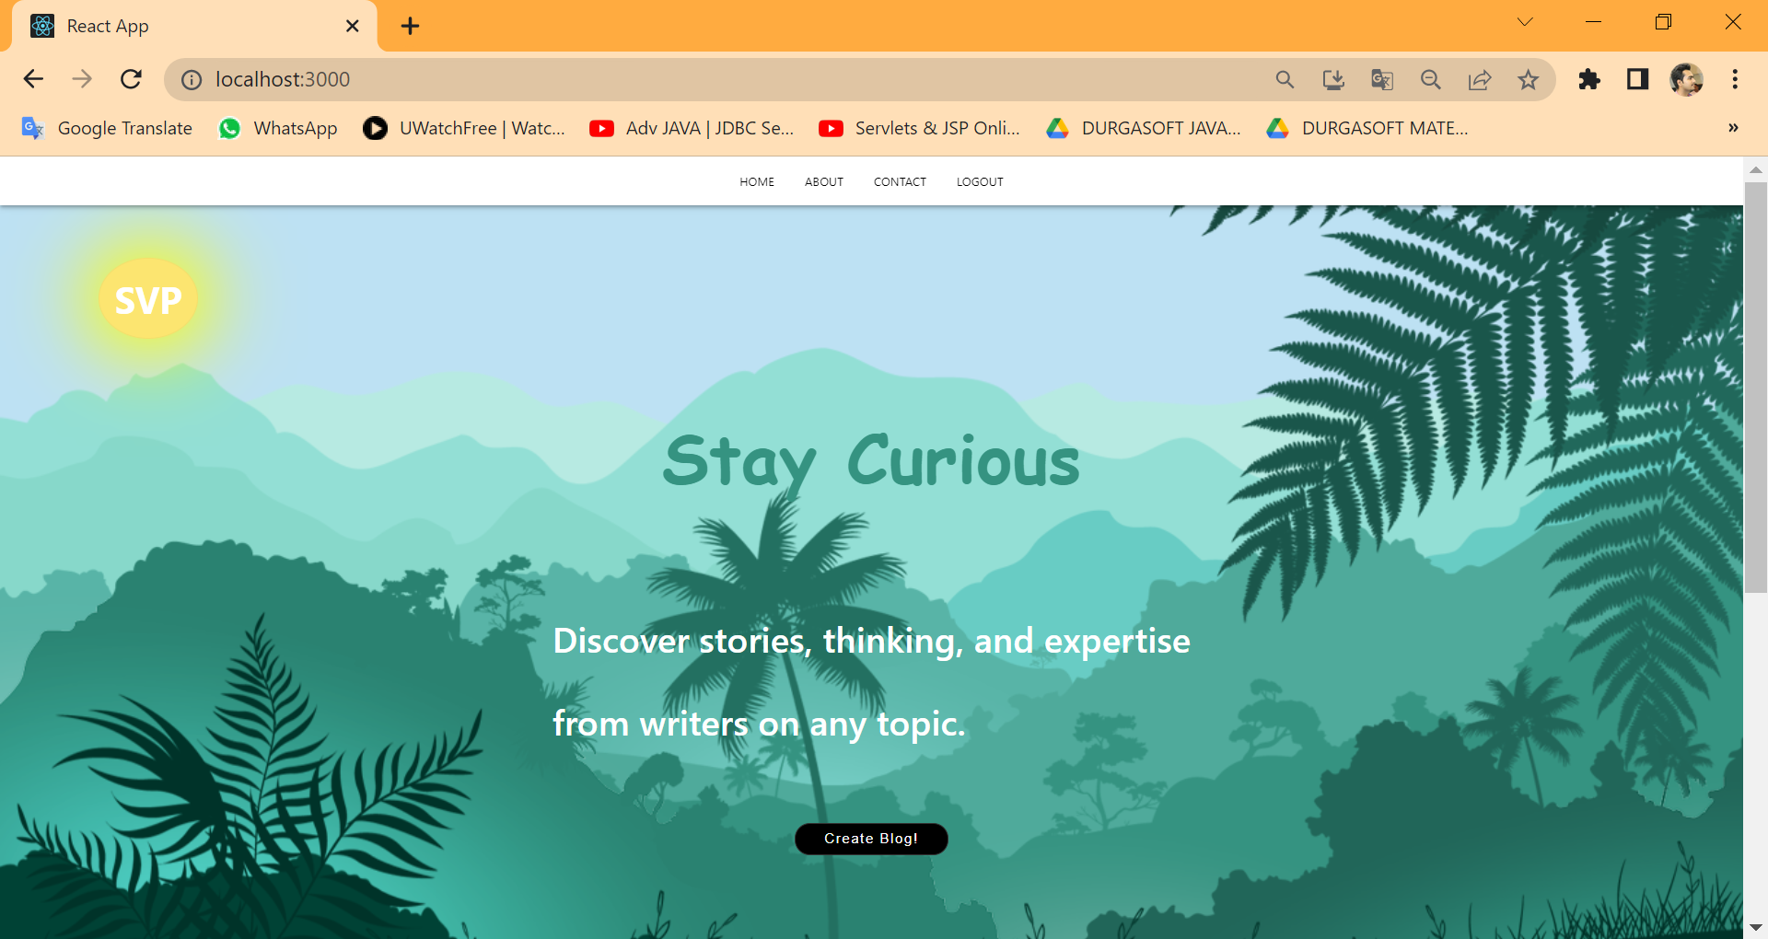
Modulus Description:
User Interface
This is a first page of website that displays the welcome screen for the user .

Slide 9
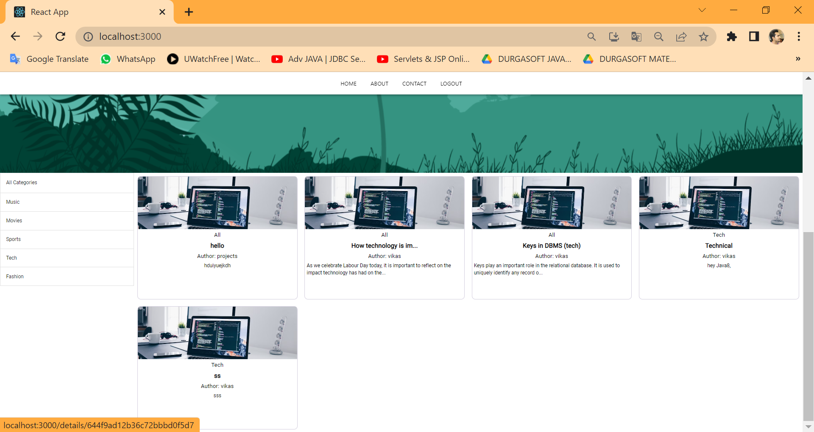
Post & Categories Page:

Slide 10
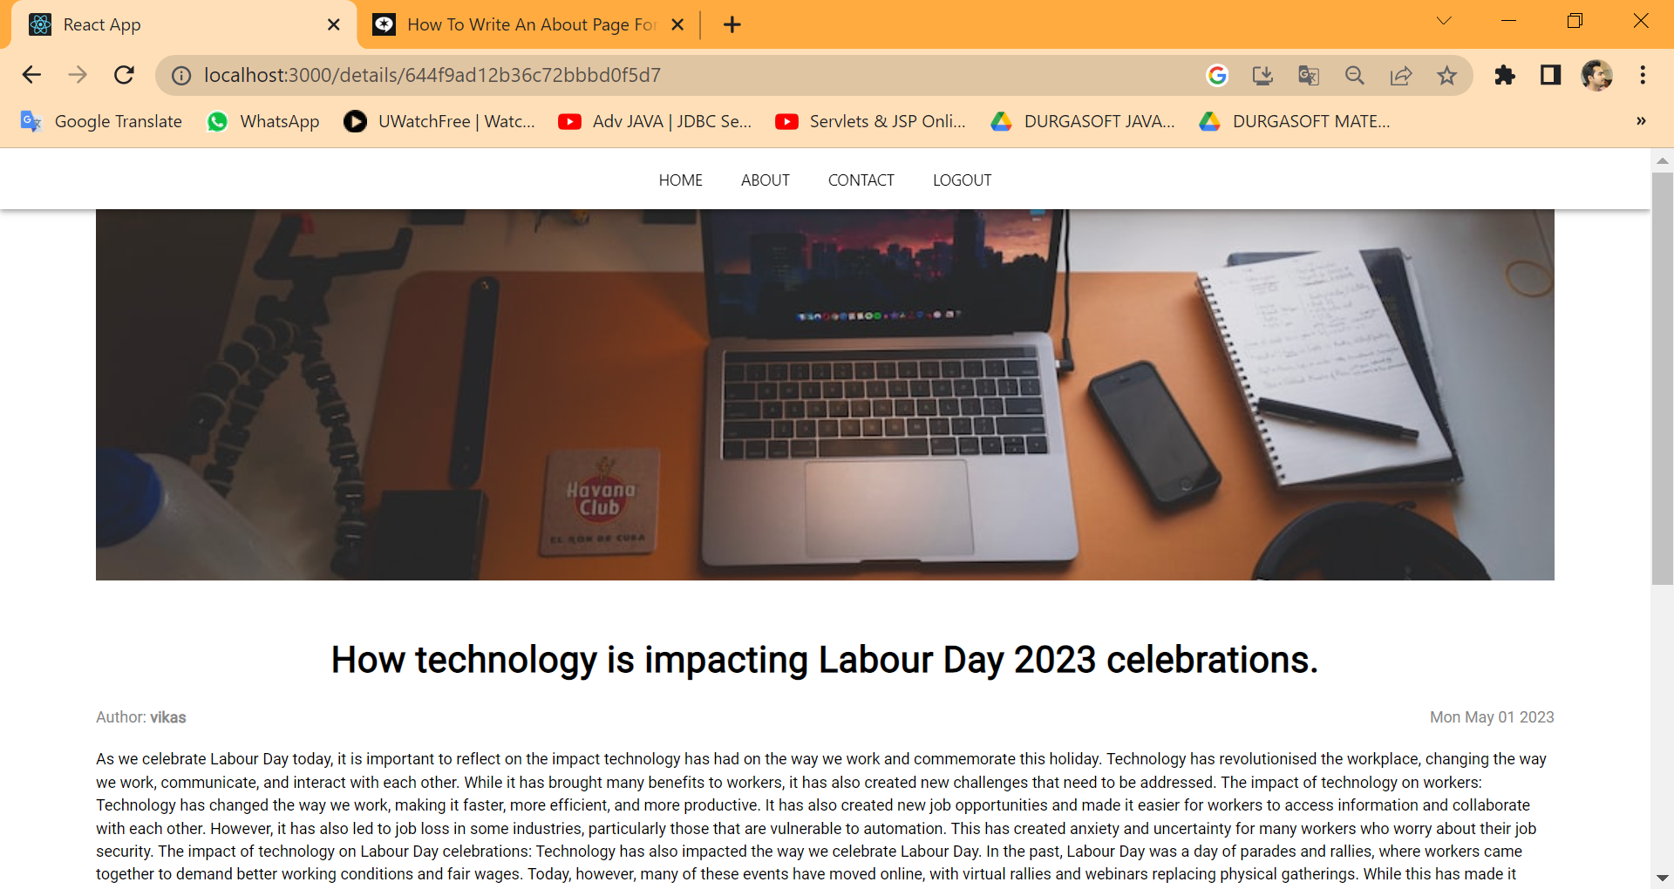

Slide 11
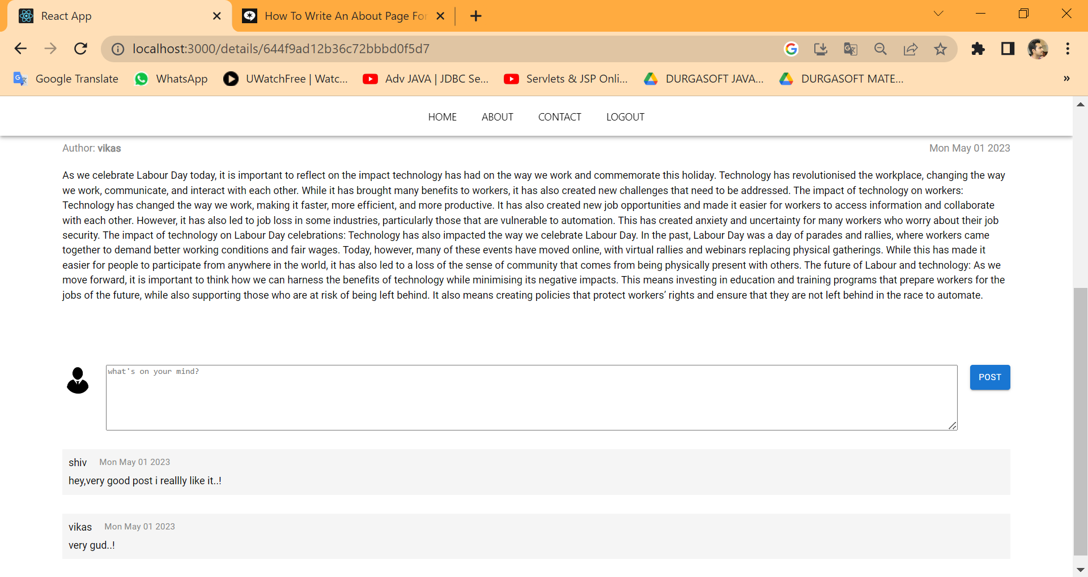

Slide 12
Report:
It generates the report on Blogs, Comment
Provide filter reports on Various Category , New Blog, Technology Blog.

Slide 13
Conclusions:
Our project is only a humble venture to satisfy the needs to manage their project work. Several user-friendly coding has also adopted. This package shall prove to be a powerful package in satisfying all the requirements of the school. The objective of software planning is to provide a framework that enables the manger to make reasonable estimates made within a limited time frame at the beginning of the software project and should be updated regularly as the project progresses.

